Slide 1

Chat Client for PC
By
(TL) Nisarg Dave (18BCP070)
Parth Prajapati (18BCP076)
Nisarg Kapkar (18BCP069)
Parth Choksi (18BCP075)

Slide 2


Synopsis
NPSquare ChatBox is a chat client for PC used for communication between two clients.
NPSquare ChatBox

Slide 3
Road Map
STEP 4
STEP 5
STEP 1
STEP 3
You can erase, restore your previous chats too.
STEP 2
You can change font color and background color too.
Enter your unique username to enter the chat.
Now enjoy chatting with your friend. Just type your message and click Send!
Host a chat or Join an existing chat.

Slide 4

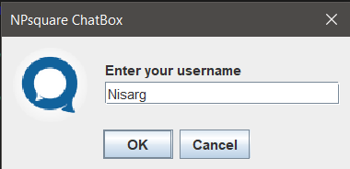
SCREENSHOTS OF STEPS
Step 1

Slide 5
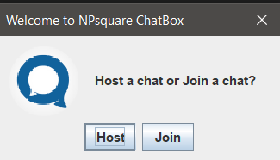
Step 2
(Host/Join Chat)

Slide 6
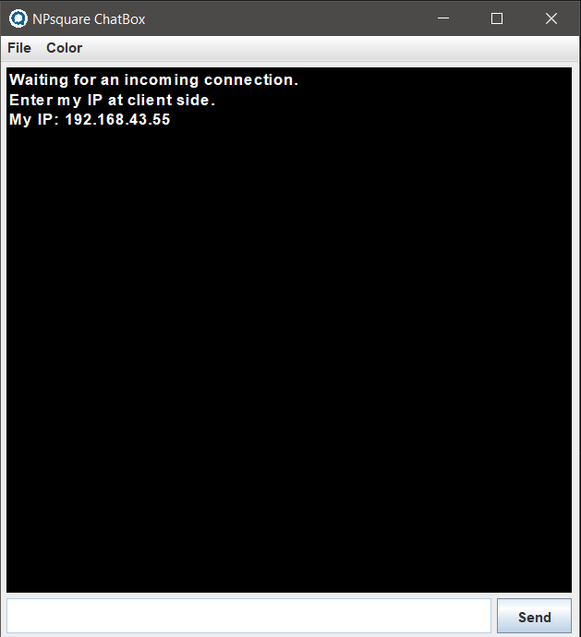
On clicking "Host"

Slide 7
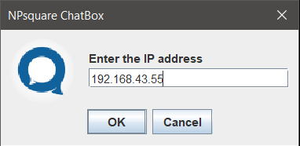
On clicking "Join" as another user

Slide 8
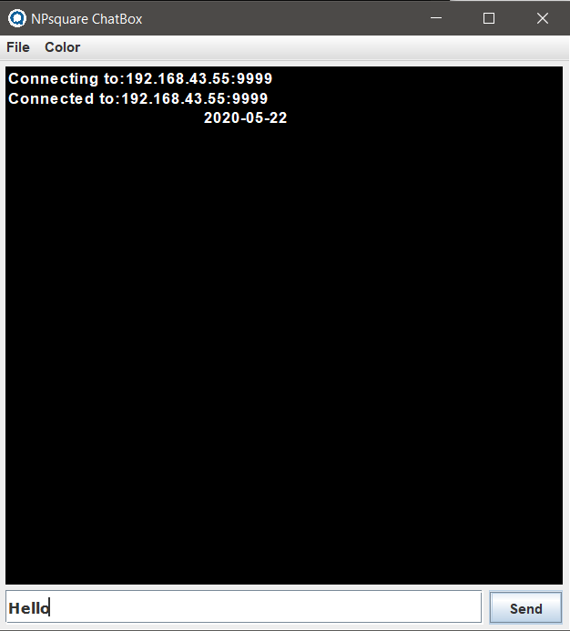
Step 3
Type message and click send

Slide 9
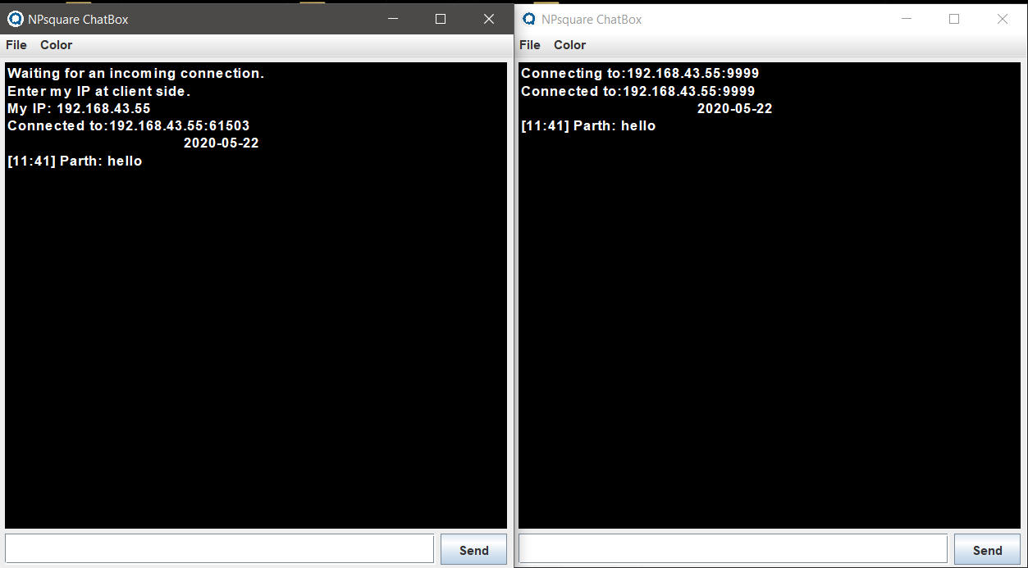
On clicking "Send"

Slide 10
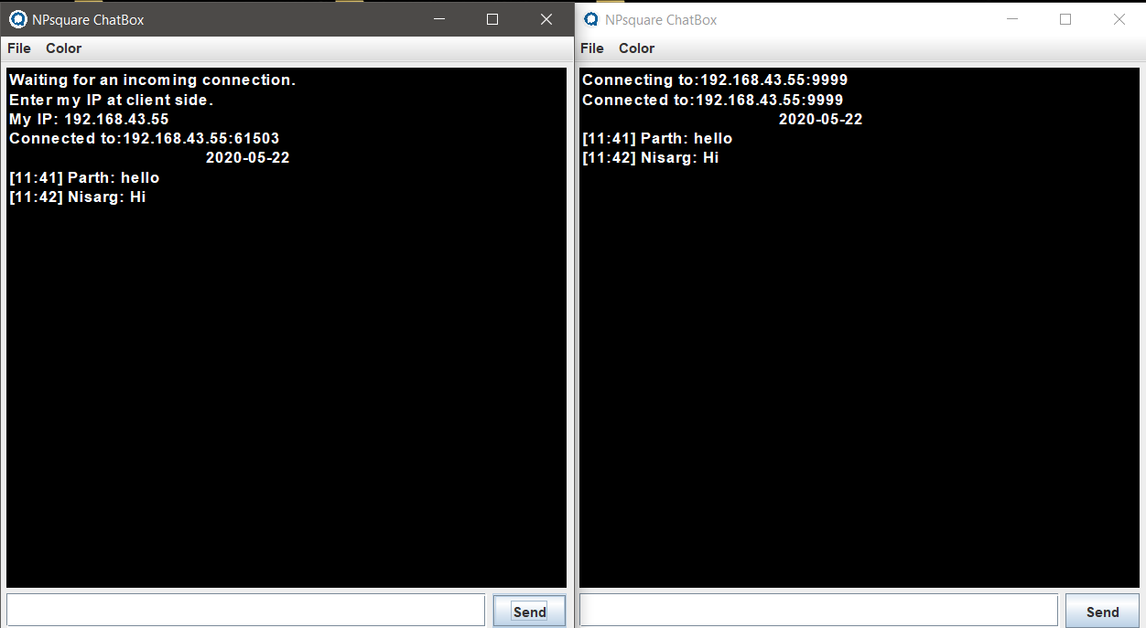
Enjoy chatting

Slide 11
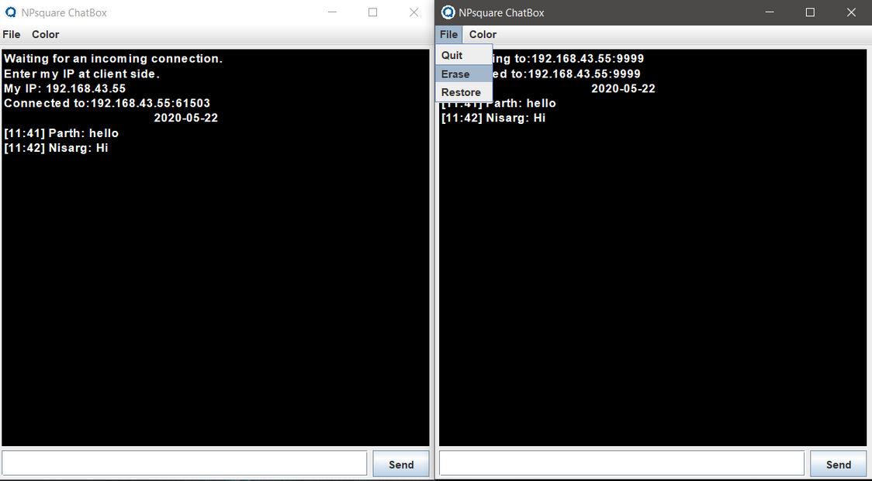
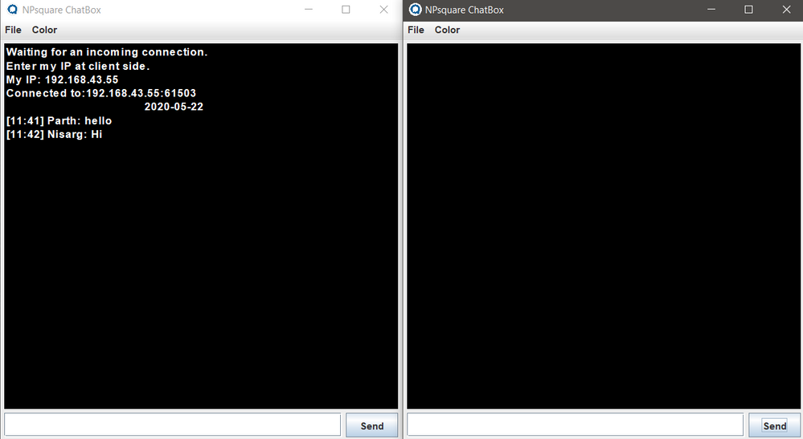
FEATURES
Erase Chat

Slide 12
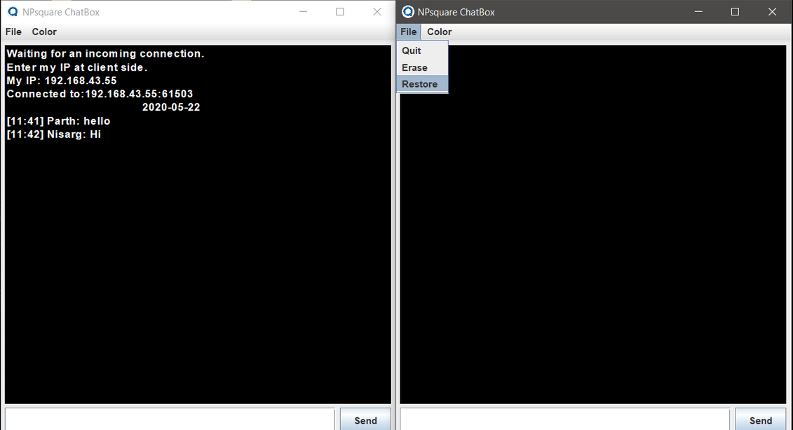
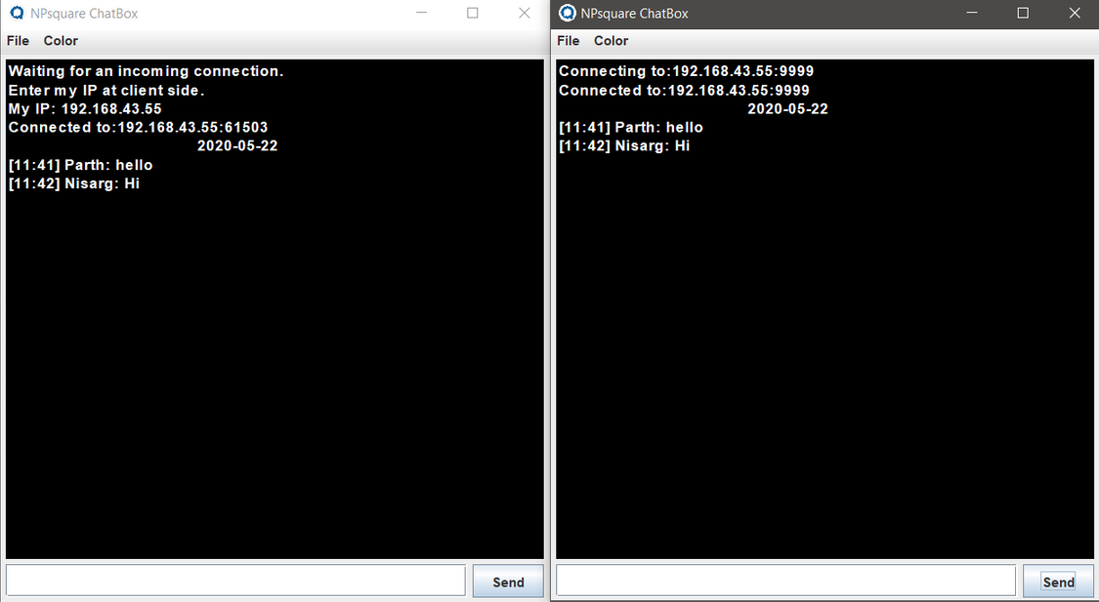
Restore Chat

Slide 13
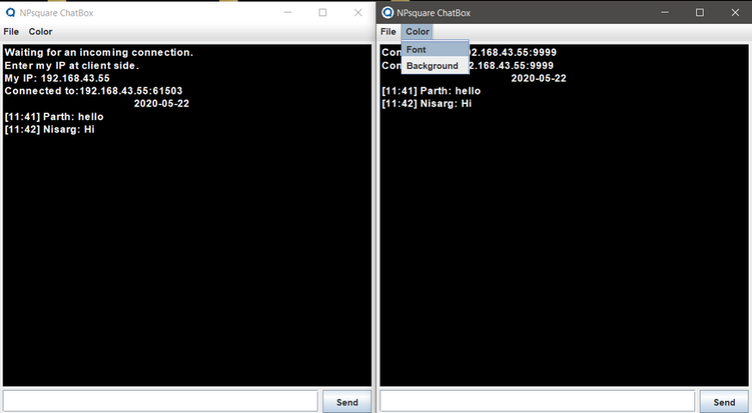
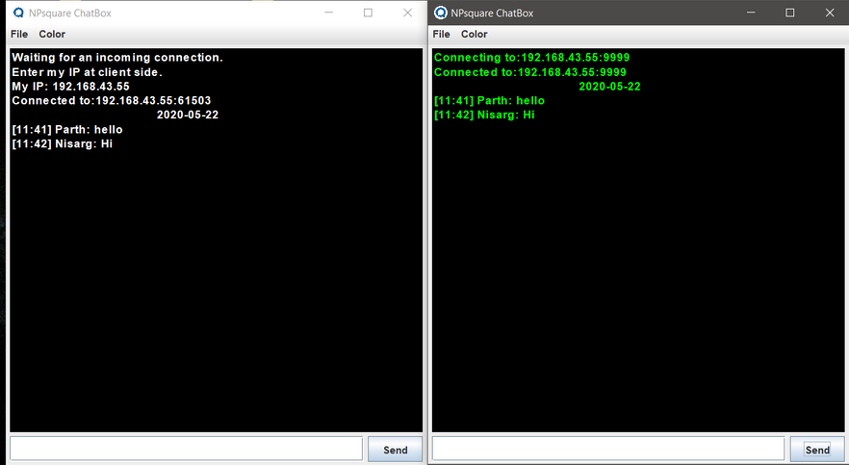
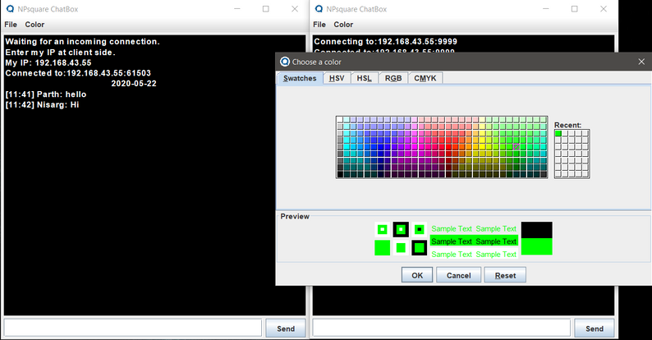
Change Font Color

Slide 14
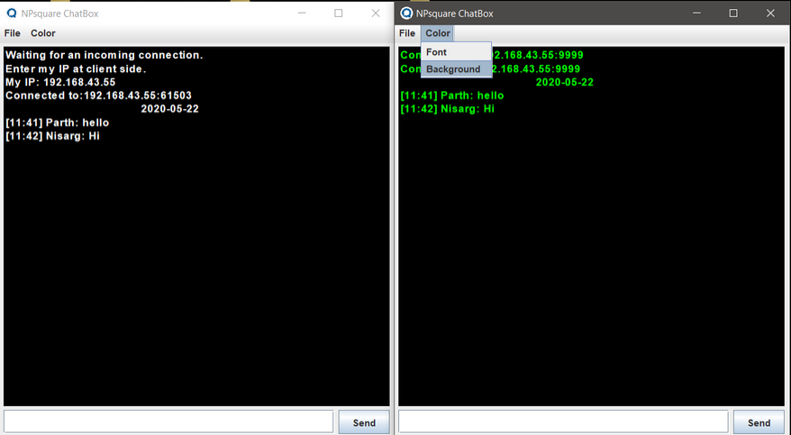
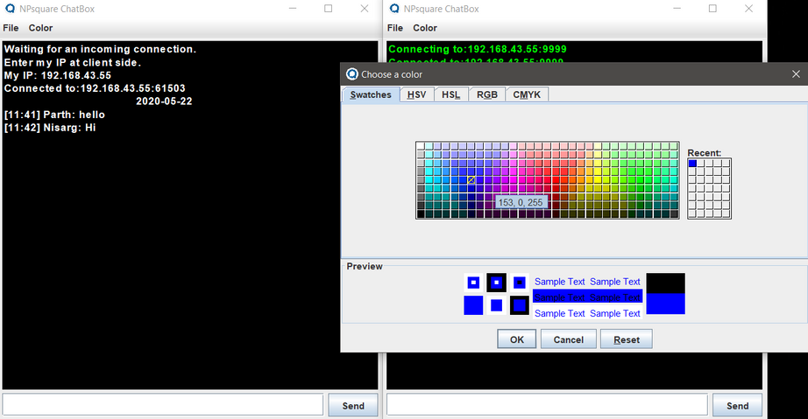
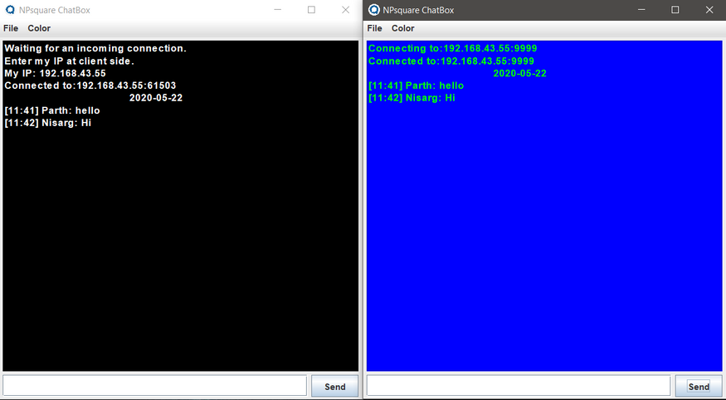
Change Background Color

Slide 15
EXCEPTION HANDLING
An exception is an unwanted or unexpected event, which occurs during the execution of a program that disrupts the normal flow of the program.
Exception indicates conditions that a reasonable application might try to catch.
Exception handler : The run-time system searches the call stack to find the method that contains block of code that can handle the occurred exception. This block of code is called an Exception Handler.
Java exception handling is managed via five keywords: try, catch, throw, throws, and finally.
There is a catch block for each type of exception that can be encountered.

Slide 16
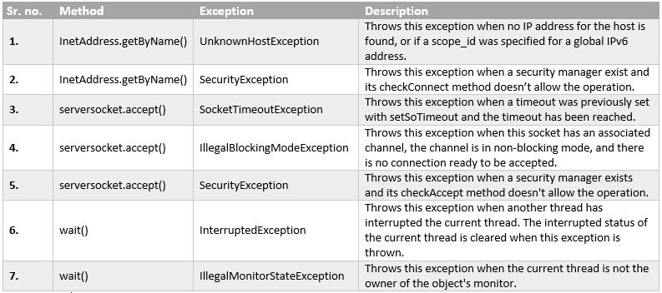
EXCEPTION HANDLING DETAILS

Slide 17
GUI-SWING APPLETS
Applets based on the Swing package are called Swing Applets.
In order to create such applets, we must extend JApplet class of the swing package.
JApplet extends Applet class, hence all the features of Applet class are available in JApplet as well, including JApplet's own Swing based features.
Swing applets provides an easier to use user interface than AWT (Abstract Window Toolkit) applets.

Slide 18
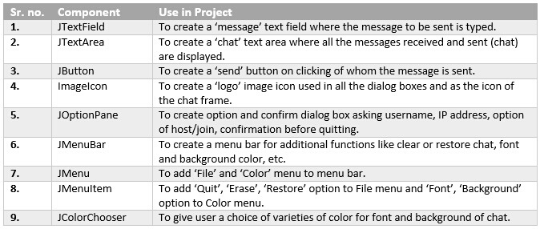
GUI IMPLEMENTATION DETAILS
Java Swing Components

Slide 19
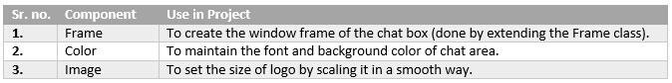
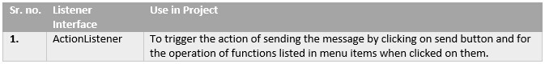
Java AWT Components
Event Handlers

Slide 20
MULTI-THREADING
Multithreading is a Java feature that allows concurrent execution of two or more parts of a program for maximum utilization of CPU. Each part of such program is called a thread.
A thread is a lightweight sub-process, the smallest unit of processing. Multiprocessing and multithreading, both are used to achieve multitasking.
In our program,we have a thread messenger which is used to execute server/client code based on user preference...which is given the option to select and accordingly the code for selected part gets executed.

Slide 21
MULTI-THREADING DETAILS
A new thread in created by
Thread messenger=new Thread();
To run the thread we use following keyword - messenger.start();
thread.sleep(time) is used to pause execution of thread for given "time"(in milliseconds)
we have used try-catch blocks to check for exceptions like InterruptedExceptions during running of program.

Slide 22
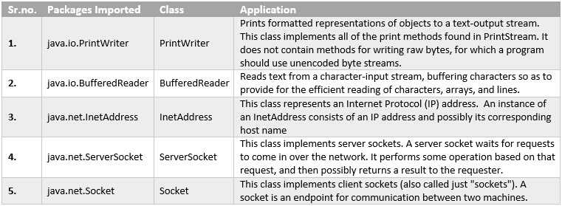
Java Network and I/O Components

Slide 23
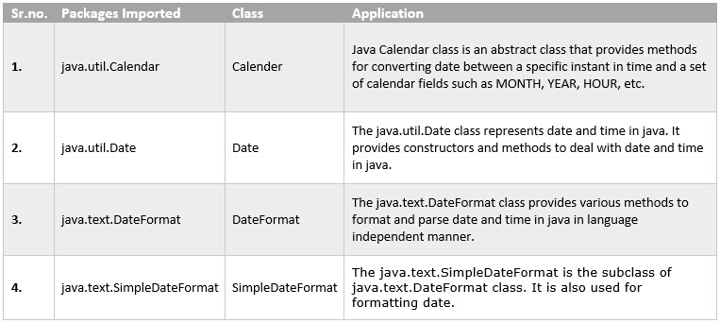
Java Date and Time Components

